Slide 1
How the Web Works
Download this slide deck and more at:
https://github.com/upenndigitalscholarship/tktk

Slide 2
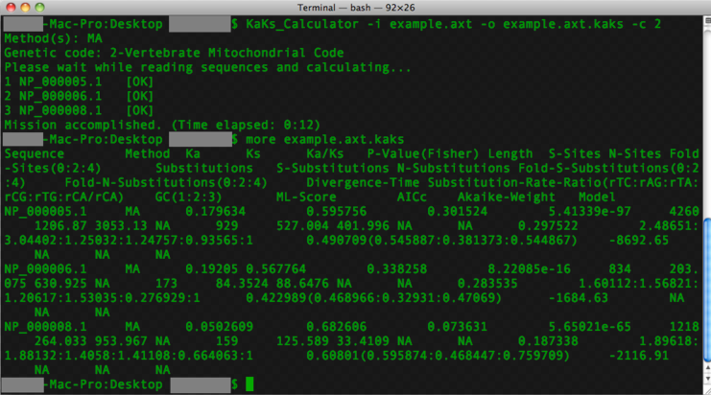

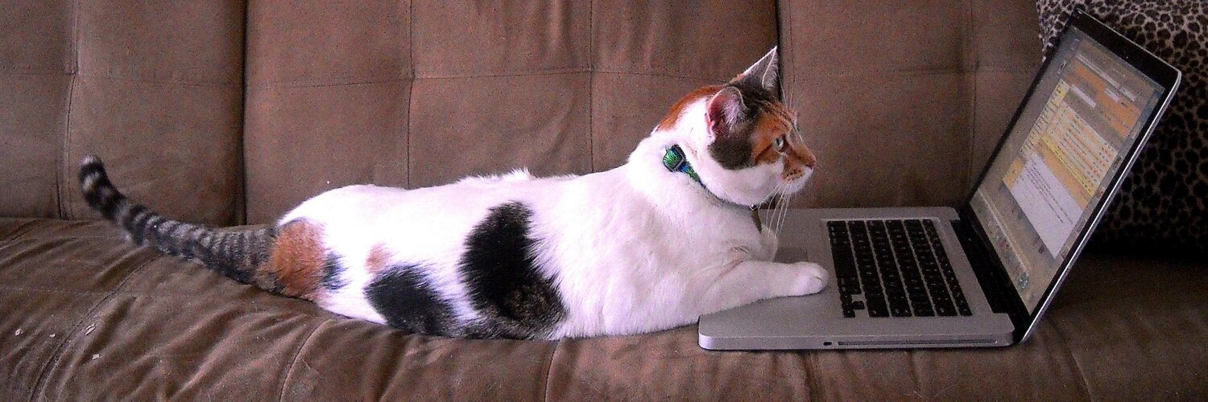
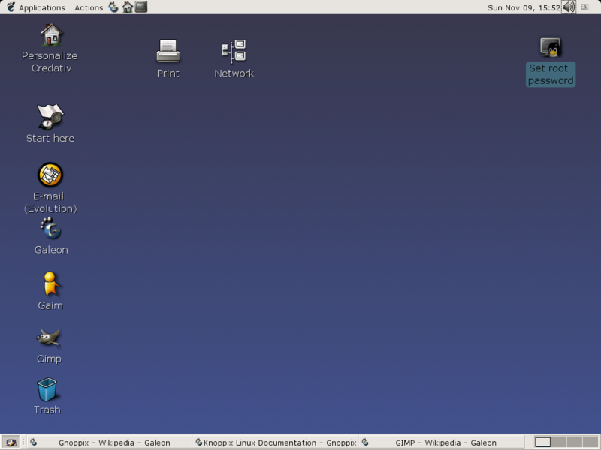
Your Computer
Command Line
Operating Environment
You
Graphical User Interface

Slide 3
Your Computer
Command Line
Programing Languages
Operating Environment
You
Programing Languages
Programing Languages
Programing Languages
Graphical User Interface
Programing Languages
Programing Languages
Programing Languages

Slide 4

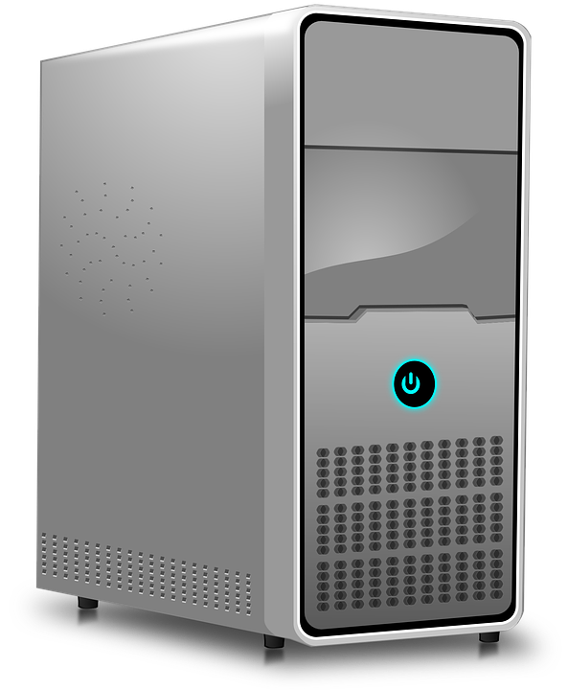


Internet
Browsers
Servers
You

Slide 5
Internet
Client-Side
HTML
CSS
Javascript
WYSIWYG Editors
Server-Side
Python
Ruby
Databases
Hosting
You

Slide 6
The Internet: Act I
Based on the heartwarming theatrical narrative by Laurie Allen:
https://github.com/dsfellows/dsfellows/blob/master/intro-to-internet/intro-to-internet-play.md

Slide 7


Hey Browser, show me
http://www.upenndigitalscholarship.org/internet/learning.html
Laurie
zzzzz…...

Slide 8
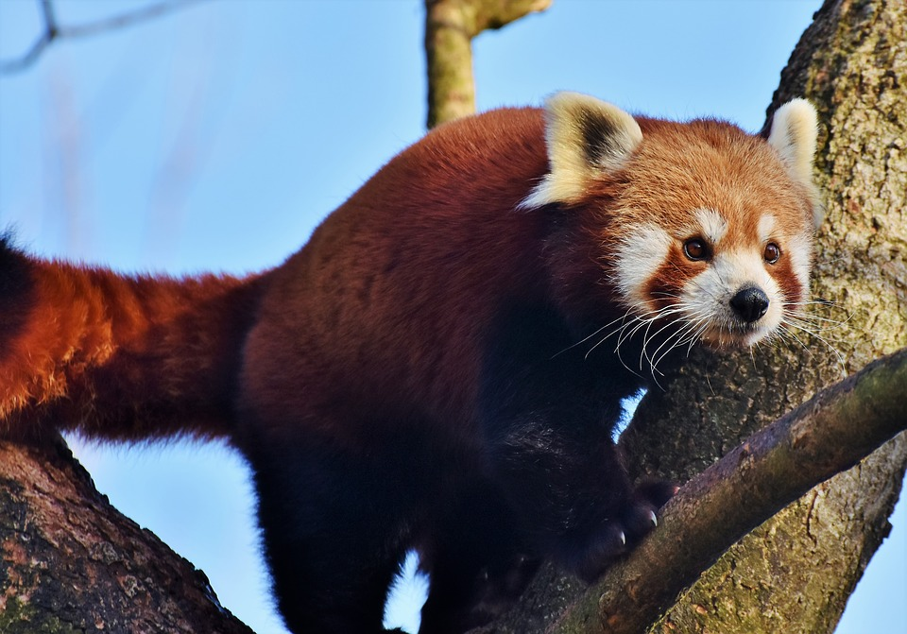

Hey Computer. Can I get on the internet? We gotta show Laurie this webpage.
Sure thing! We seem to be all hooked up to the internet, so I don't see a problem.

Slide 9
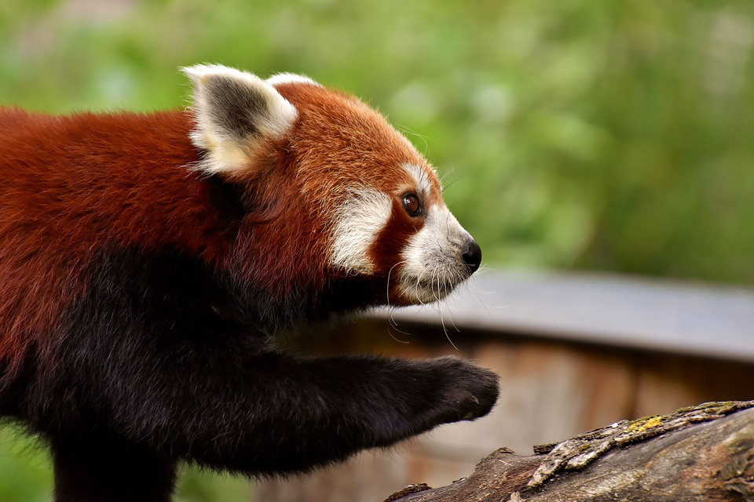
To the DNS Office!

Slide 10

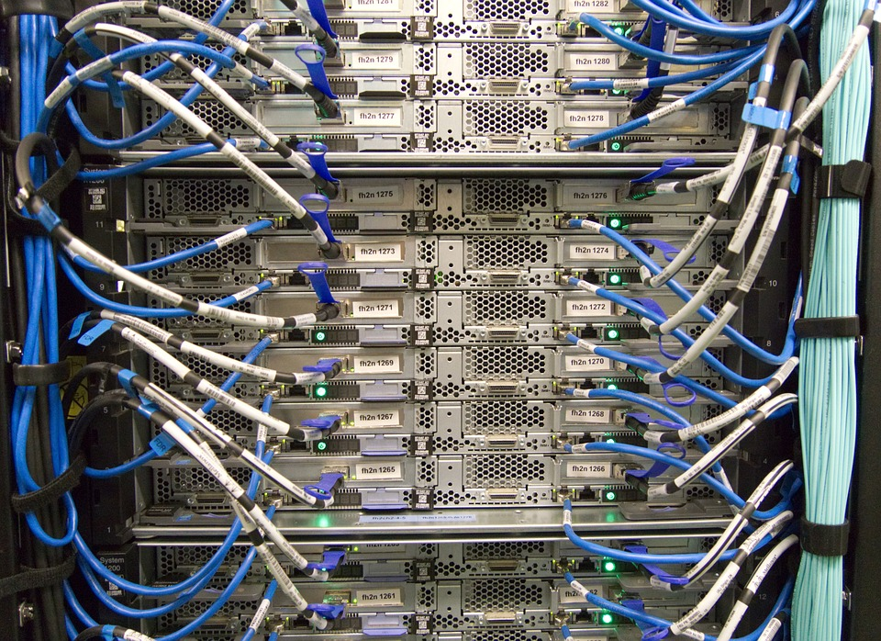
DNS Office
Hey Domain Name Service, Laurie's agent here. I’m looking for upenndigitalscholarship.org. Can you tell me where to go?
Ah. Ok. I see that the University of Pennsylvania Libraries has signed up for that domain name. They’ve got a server running on a computer over there in a server farm provided by Reclaim Hosting. They should be serving up that site at 128.39.28.2833

Slide 11

Got it. On my way!
Our Agent travels to "cloud", which is one of many warehouses full of computers that store and serve the sites you visit. These warehouses full of computers are staffed and require massive electricity and temperature controls. The huge quantity of water required for cooling these warehouses has real environmental consequences. There is no cloud. There are wires and computers on earth.

Slide 12

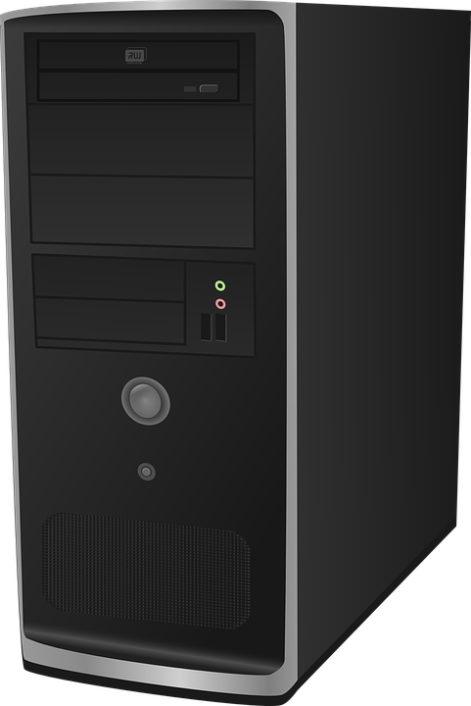
128.39.28.2833
Hellooo 128.39.28.2833. I heard you have a web server on this computer here. I'm going to go in and look for the files I'm searching for, cool?
Yes. Welcome. What page would you like?

Slide 13


128.39.28.2833
Well, I seem to be looking for a directory called "internet", ah. I see you've got that folder, I'll just take a look. I'm trying to find a file called "learning.html"?
Yep. Here's that file... It’s an html page -- great! Off you go!!
learning
internet

Slide 14
Come on, buddy! I’ll show you the way back to Laurie’s computer.
learning
The story continues at https://github.com/dsfellows/dsfellows/blob/master/intro-to-internet/intro-to-internet-play.md

Slide 15
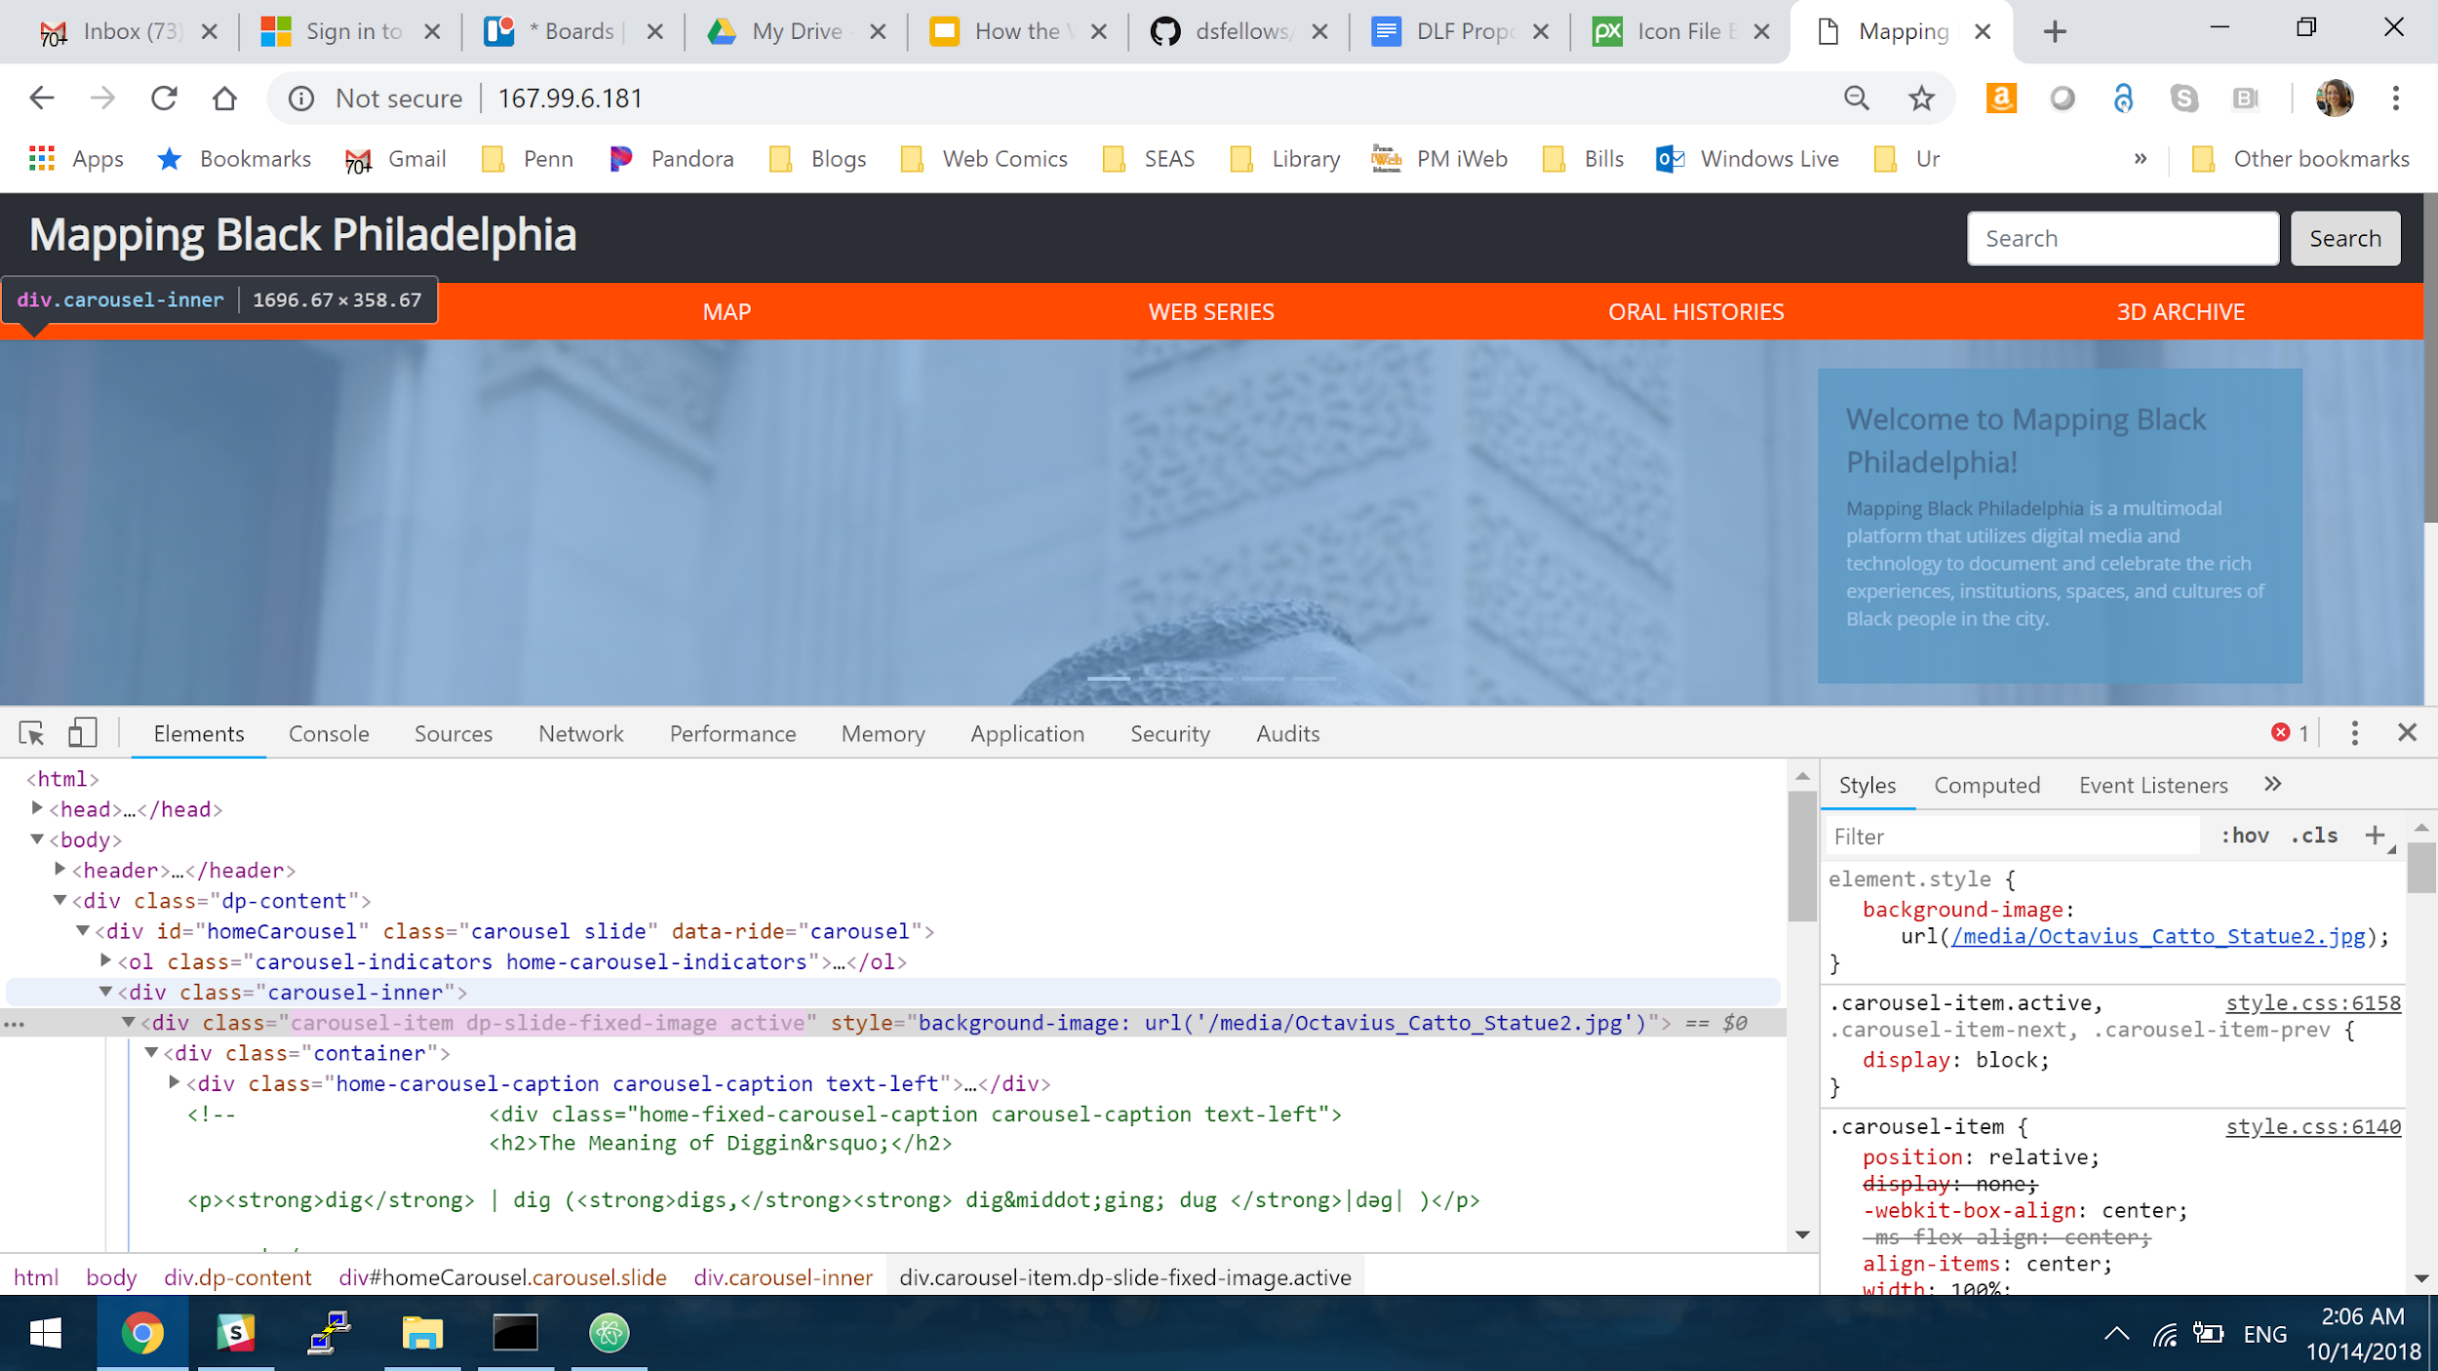
Inspect web pages using Right/Command Click & Inspect

Slide 16
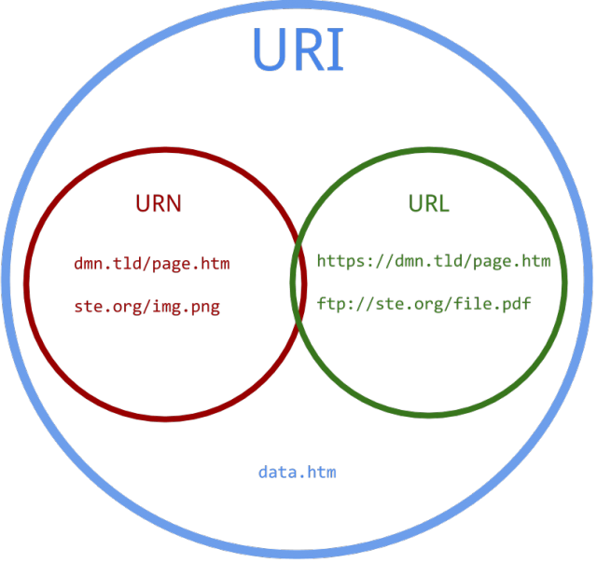
https://danielmiessler.com/study/url-uri/#gs.WoTZEW8
Notes:
http://www.ur-online.org/subject/12301/

Slide 17

Responsive Web Design - Designing for Mobile

Slide 18

Application Programming Interface - Connecting One Application to Another

Slide 19

Linked Open Data - Creating a Network of Context

Slide 20
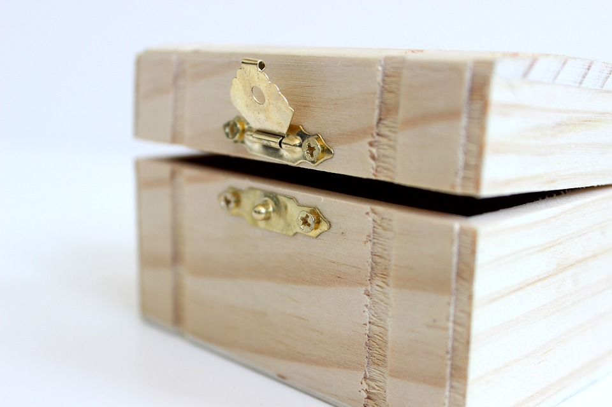

Open Source vs. Proprietary

Slide 21

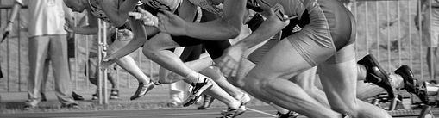
Waterfall
vs.
Agile

Slide 22
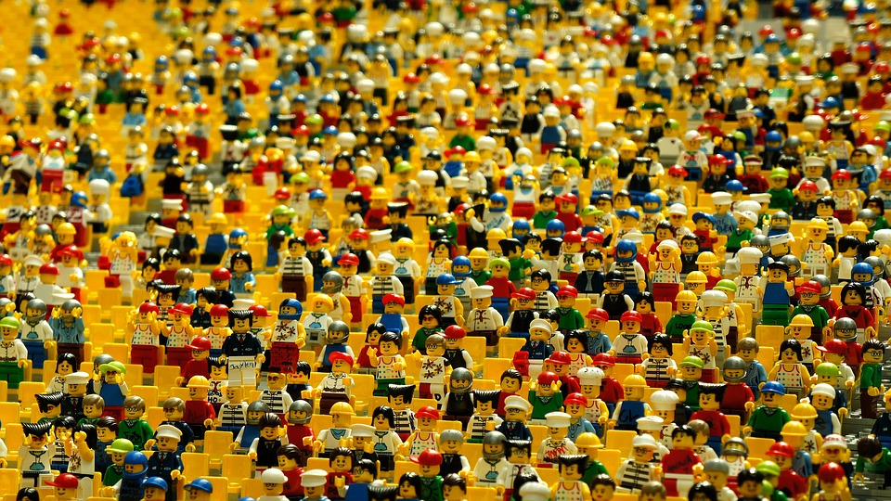
User Stories
> Describe who & what (but not how!)

